Slide 1
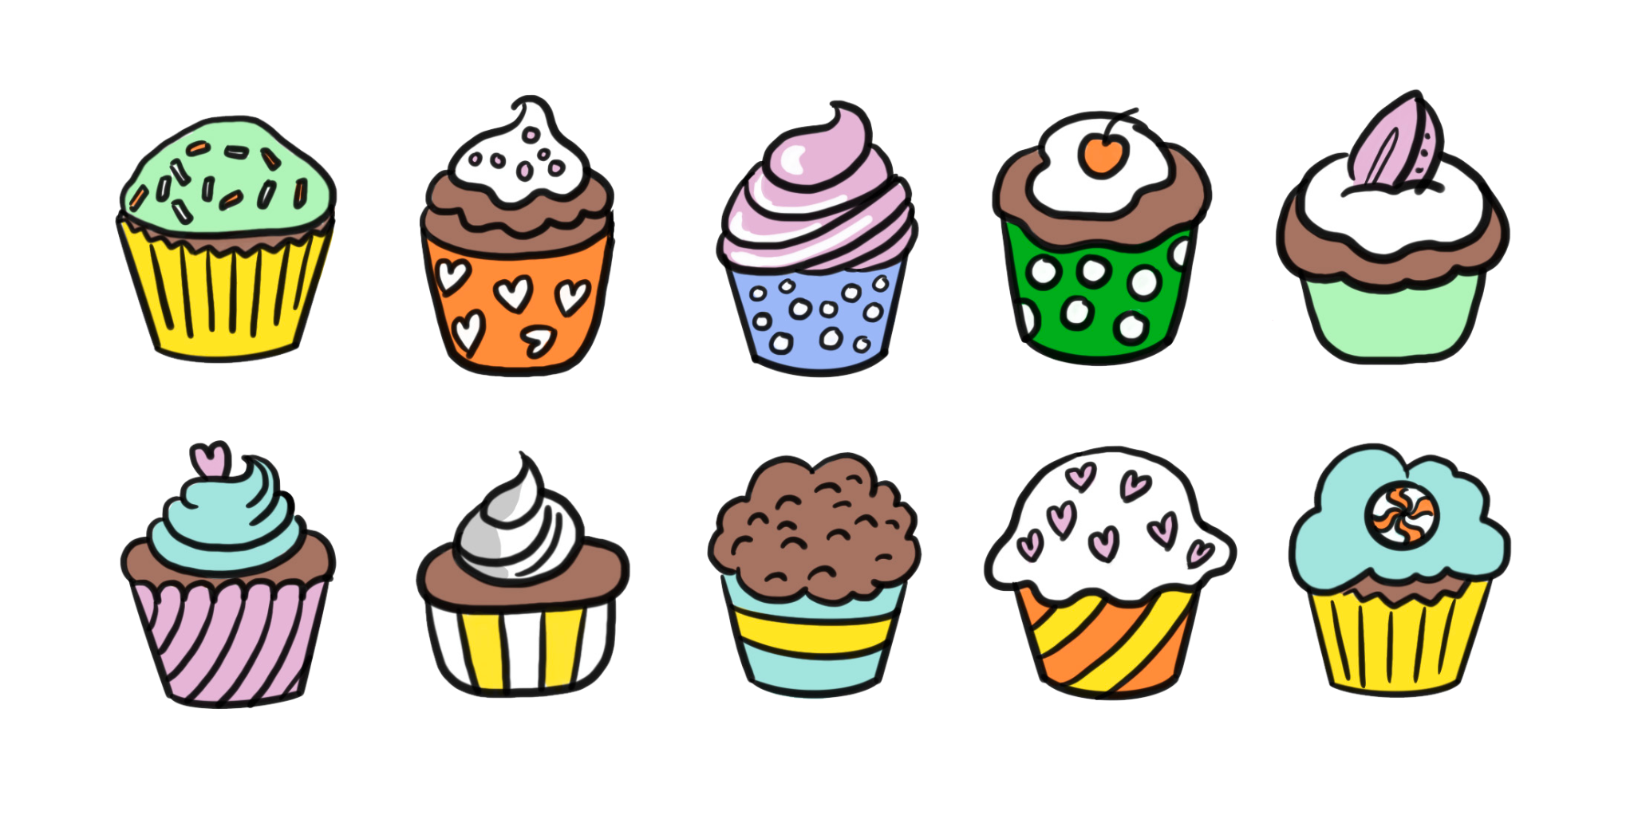
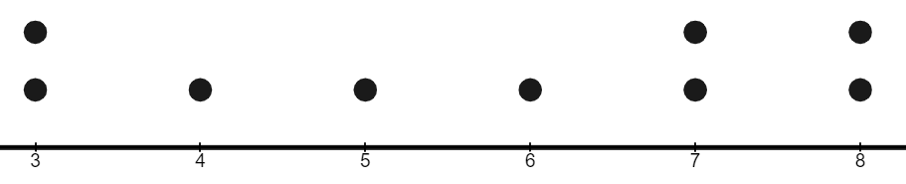
Understanding the median
Task A: Finding the middle in small data sets
Each tray has some cupcakes. What is the median number of cupcakes?
4 cupcakes
2
3
4
5
6
Some data are shown on the dot plot. What is the median value?
6
3
4
5
6
7
8
If possible, find the median for these data sets
16, 32, 29, 19, 30, 42, 51, 29, 25, 28
avocado, beetroot, carrot, damson, edamame, fig
-3, -9, -3, -7, -2, -10, -1
16, 19, 25, 28, 29, 29, 30, 32, 42, 51 the median is 29
no median for these data
-10, -9, -7, -3, -3, -2, -1
the median is -3

Slide 2
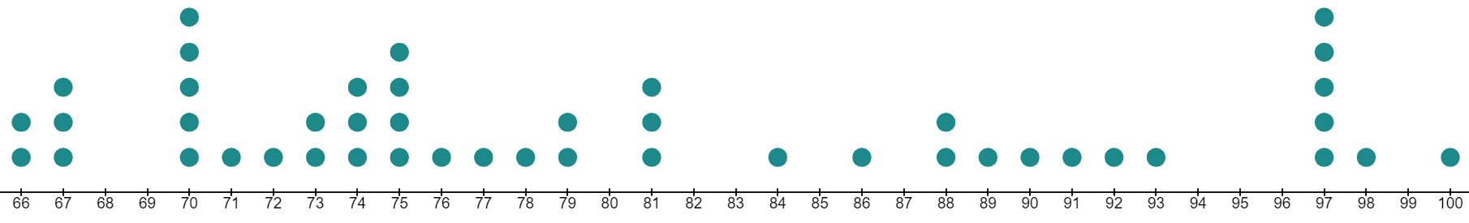
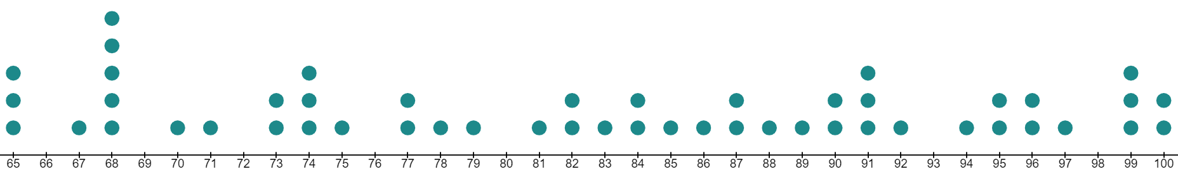
Understanding the median
Task B: Finding the middle in large data sets
1) Work out the position of the median in each case
a) 425 data points
b) 327 data points
c) 2389 data points
d) 412 data points
e) 5686 data points
213th piece of data
164th piece of data
1195th piece of data
206.5th piece of data
- the mean of the 206th and 207th data values
2843.5th piece of data - the mean of the 2843rd and 2844th data values
Work out the median from each dot plot
a)
77
b)
83.5
Here there are 97 pieces of data in order.
4.4, 4.6, 5.4, 5.5, 5.7, 6, 6.2, 6.5, 6.6, 6.8, 7.5, 7.9, 8.2, 8.3, 8.4, 8.4, 8.8, 8.8, 8.8, 9.2, 9.5, 9.6, 9.6, 9.6, 9.8, 9.9, 9.9, 10.1, 10.2, 10.3, 10.3, 10.5, 10.6, 10.9, 10.9, 11.2, 11.3, 11.4, 11.6, 11.6, 11.8, 12.3, 12.5, 12.6, 13.2, 13.3, 13.3, 13.9, 13.9, 14.2, 14.2, 14.4, 14.5, 14.8, 15.3, 15.4, 15.4, 15.5, 16.1, 16.6, 16.6, 17.1, 17.3, 17.3, 17.4, 17.7, 17.7, 17.8, 18.2, 18.3, 18.3, 18.3, 18.4, 18.4, 18.5, 18.5, 18.7, 18.9, 18.9, 19, 19.1, 19.2, 19.3, 19.6, 20, 20, 20.1, 20.9, 20.9, 21.1, 21.2, 21.6, 22.1, 23.1, 23.3, 23.5, 25.9
What is the median value?
The piece of data in the 49th position → 13.9
4) There are 2000 items in the data set in total. The part of the list shown starts at the 998th entry. What is the median for this data set?
…, –4.5, –4.5, –4.2, –3.9, –3.3, –2.1, –2.0, –0.8, –0.1, 0, 0, 0.2, 0.2, 0.2, 1.7, 1.8, …
998th
Median = -4.05
Mathematics in Education and Industry
v2.2

